Slide 1
Conference Proposal
By Sherill Spruill
Dowling College
EDE 9800
Dr. Morote – Instructor
August 2013

Slide 2
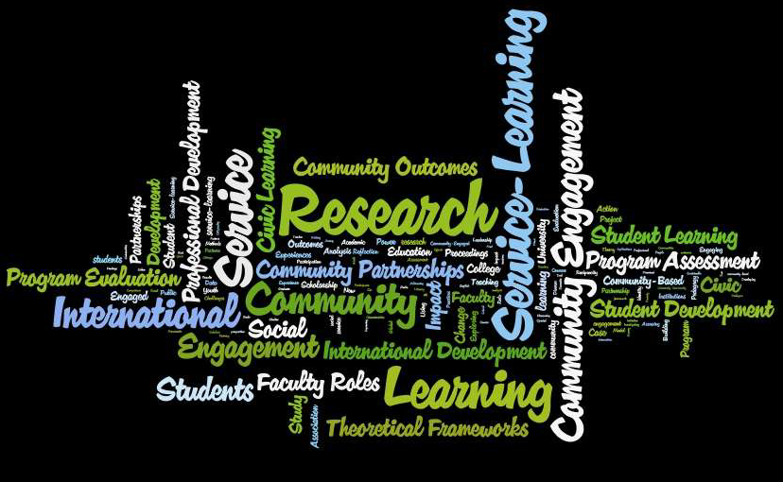
22nd National Conference on Family Literary Research Strand 2013 Goodling Institute for Research in Family Literacy Pennsylvania State University

Slide 3
Culturally Relevant Reading and Math Instruction www.ed.psu.edu/2013-ncfl-conference-proceedings/view
The purpose of this study was to implement culturally relevant pedagogical skills into math and reading and explore its’ affect on how instructors teach children from socioeconomic backgrounds.

Slide 4
Literature Review
According to the National Association for the Education of Young Children and the National Council of Teachers of Mathematics (2002), specific curriculum which is culturally matched with the student demographic is highly effective in increasing student achievement in math and reading.
As English and Spanish are languages, math is a language (Adams, 2003), and can be comprehended by preschoolers
when connected to prior cultural knowledge. Implementing math storybooks into conventional reading material can solidify a foundation on which future academic achievement can be built.

Slide 5
Literature Review (p. 2)
Children must have the opportunity to utilize the math language in their cultural lifestyle (Capraro et. al., 2011). According to research, abstract thinking skills required to understand mathematical concepts can be developed in preschool children by starting at the foundational level of understanding, then build better comprehension of abstract concepts (Miller & Mercer, 1997,1993). Having a vast mathematic vocabulary is essential for students to succeed in the discipline. The same is true for reading (Capraro & Joffrion, 2006). True learning occurs when there is understanding of the subject matter. Implementing culturally relevant materials into the curriculum such as math storybooks, can assist students in making connections to previously learned material.

Slide 6
Literature Review (p. 3)
This study focused on the pedagogical techniques of eight tutors who utilized math and reading skills to teach socioeconomic preschoolers by using math storybooks. The focus was to monitor how the use of culturally relevant pedagogy improved student achievement and transformed conventional teaching techniques.
A mobile RV unit renovated into a classroom was setup in an urban housing complex once weekly for three months.

Slide 7
Literature Review (p. 4)
This unit contained:
Thirteen laptop computers
Five flat screen televisions
Tables
Chairs
This venue supplied free tutoring in mathematics via culturally relevant pedagogy to students from first to twelfth grade; however, preschool achievement was the focus for this study.

Slide 8
Literature Review (p. 5)
Each session was sixty minutes in length. The tutors were monitored on the frequency cultural relevant pedagogy was used and if this invoked positive cultural responses from the students in the form of personal experiences and group discourses. After each lesson, tutors discussed the week’s work and their perceptions of what occurred during the lessons. Tutors were then given instructions as to the lesson focus for the proceeding week; each focusing on a specific behavior.

Slide 9
Literature Review (p. 6)
At the end of the study, all tutors reported a fifty percent pedagogical strategy adjustment due to positive student increases in mathematical knowledge and reading skills.
According to Godwin and Hubert (2013), resulting analysis data disseminated into three themes:
Mathematics Vocabulary
Interest and focus level
Development of reading habits

Slide 10
Literature Review (p. 7)
Tutors’ use of storybook time an increase in math vocabulary was observed among preschool students.
Implementing objects culturally familiar to them such as Fruit Loops, Goldfish and M&M’s helped students connect and quickly utilize new material. Therefore, both tutors and researchers believe new material can be learned easily through lessons which are culturally applicable. Culturally relevant pedagogy assists students in connecting previously learned material with new material based on natal culture.

Slide 11
Research Design
Research Type: Qualitative
Tools Used: Surveys, RV mobile bus, math storybooks, Goldfish, Fruit Loops, M&M’s
Setting (main focus): Preschool children in an urban housing complex from socioeconomic backgrounds
Participants: 8 Tutors (college students or graduates)

Slide 12
Future Implications
Culturally relevant pedagogy has the ability to ignite student achievement by creating connections between new subject matter to previously learned material by using familiar elements from students’ natal culture.

Slide 13
References
Adams, T. L. (2003). Reading mathematics: More than words can say. The Reading Teacher, 56(8), 786-795.
Capraro, M., & Jaffrion, H. (2006). Algebraic equations: Can middle-school students meaningfully translate from words to mathematical symbols? Reading Psychology, 27, 147-164. doi: 10.1080/02702710600642467
.
Capraro, R. M., Capraro, M. M., & Rupley, W. H. (2011). Reading-enhanced word problem solving: a theoretical model. European Journal of Psychology of Education, 27, 91-114.
doi: 10.1007/s10212-011-0068-3.
Gojak, Linda. (1920). National Council of Teachers of Mathematics. Retrieved from http://www.nctm.org

Slide 14
References
Hill, Patty. (1926). National Association for the Education of Young Children. Retrieved from www.naeyc.org
Miller, S. P., & Mercer, C. D. (1993). Using data to learn about concrete-semi-concrete-abstract instruction for students with math disabilities. Learning Disabilities Research and Practice, 8(2), 89-96.
Miller, S. P., & Mercer, C. D. (1997). Educational aspects of mathematics disabilities. Journal of Learning Disabilities, 30 (1), 47-56
.

